Slide 1
Keywords and Identifiers

Slide 2
Keywords and Identifiers
input clk;
reg value;
wire Cout;
parameter width = 3;
Keyword Identifier

Slide 3
Verilog Keywords
Verilog uses about 100 predefined keywords. All the keywords are represented in colored font.
All the Verilog statements are terminated with a semicolon(;) except for the statements like begin, always, if, for, while, etc.
Verilog is case sensitive i.e. the keywords are written in lower case.
Single-line comment is given by two slashes: //
and multi-line comment is given by: /*……… */
e.g. // This is a sample comment
/* This is a multi-line
sample comment*/

Slide 4
Verilog Keywords
Most common keywords are
module, endmodule
input, output
wire, reg, parameter
always, initial
for, while, if, case
begin, end
and, or, not, xor, xnor, nard, nor
posedge , negedge
$display, $print, $monitor
$vw_dumpvars, $stop, $finish

Slide 5
Identifiers
Identifiers are names to given to objects so that they can be referenced in the design.
Legal identifiers
john_smith
JohnSmith1
_john2john
My$sign
Illegal identifiers
2JohnSmith
$sign
John*2
house#3

Slide 6
Data Types
Nets
Registers
Parameters

Slide 7
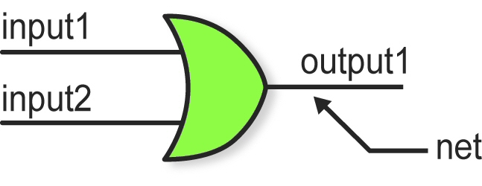
Nets
Nets represent connections between hardware elements i.e. wires.
Nets have values continuously driven on them by the outputs of devices they are connected to.
The default value of wire type is z (high-impedance).

Slide 8
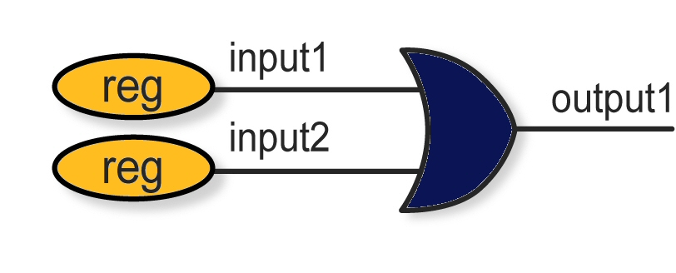
Registers
Registers represent data storage values, and hold their values until a new value is explicitly assigned.
Do not confuse with the hardware registers built from flip-flops.
Used in behavioral models and simulations
The default value of reg type is x (unknown).

Slide 9
Parameters
Parameters represent run-time constants.
Parameters cannot be used as variables.
An example:
parameter width = 5;
wire [width-1:0] signal; // a wire net declaration using parameter

Slide 10
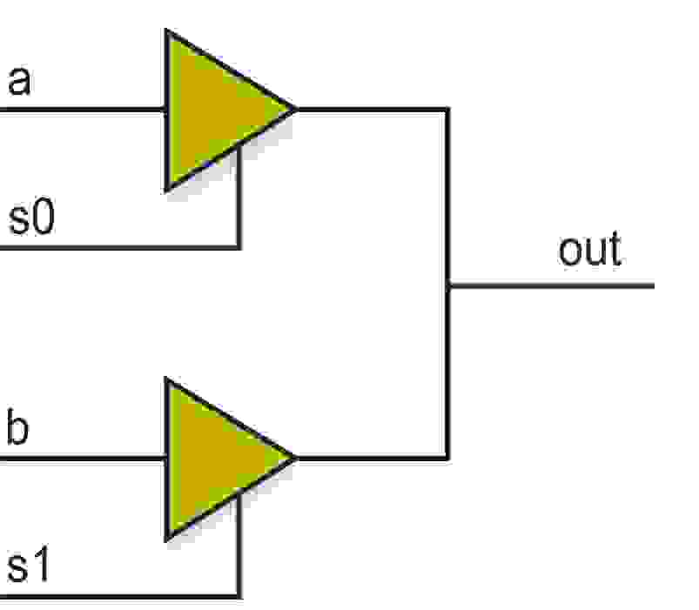
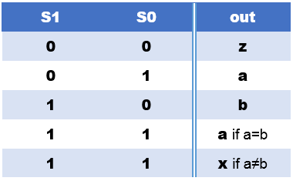
Logic Values
Nets and registers take four values: 0, 1, x, z
z: Output of an undriven tri-state driver
x: Models when the simulator can’t decide the value

